Slide 1
Stellar Competition

Slide 2
Procedure
Train-valid split
Feature Engineering
“Divide-and-Conquer” Modeling
Stacking
Rounding
More-days lagging

Slide 3
How to “cheat”?
Although it is not valid to bundle current transactions or use future value, we can get some ideas of it in this way.
Unit price = fee_charged / (#ops + bool(fee_account)). It is a CONSTANT in one sequence. So the way to get yesterday’s unit price is very simple. You can achieve 0.000 error in this way.

Slide 4
Feature Engineering 0: Group data by sequence
If the unit prices by sequences are all the same, we just need to predict the unit price by sequences instead of transactions.
Aggregation methods are needed for some features and we will discuss that later.

Slide 5
Feature Engineering 1: Last Unit Price
We cannot directly calculate the unit price in test set.
Unit Price = prior_min_fee_charged / min(#ops + bool(fee_account))

Slide 6
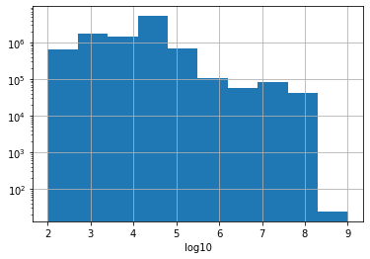
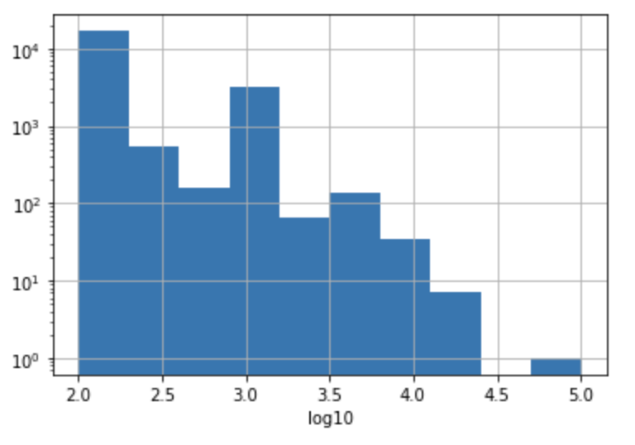
Feature Engineering 2: Price Binning
How to aggregate the price? We created 6 bins (left: unit_bid_price, right: unit_fee)

Slide 7
Feature Engineering: All columns
'transaction_operation_count', 'avg_fee', 'price2', 'price3', 'price4', 'price5', 'price6', 'price7', 'prior_successful_operation_count', 'prior_failed_operation_count', 'prior_successful_transaction_count', 'prior_failed_transaction_count'
All the columns without the word “prior” are shifted by 1 (which means last seq)

Slide 8
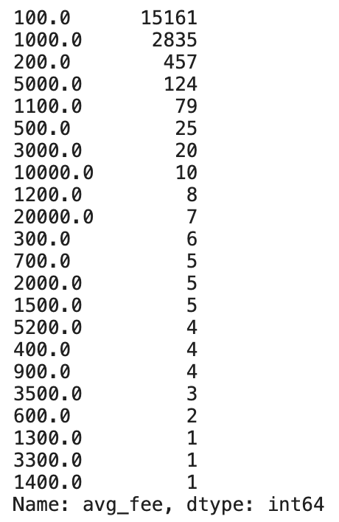
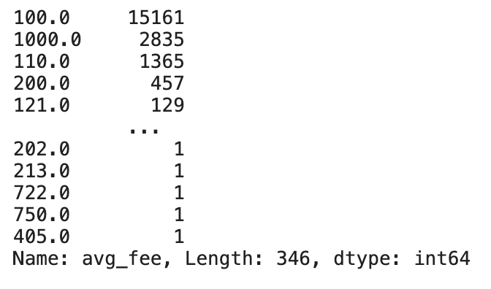
Modeling: Decision Tree
Why not neural network? Why decision tree?

Slide 9
Divide-and-Conquer
Decision Trees we learned in COMS 4995: Random Forest, Xgboost, LightGBM, Gradient Boosting, Histogram Gradient Boosting
We would like to add another model: ExtraTreeRegressor (This actually performs the best in the result.)

Slide 10
Stacking
0.2 * random_forest + 1.2 * ExtraTree + 0.5 * Xgboost - 0.9 * LightGBM
Discarded: Histogram Gradient Boosting, Gradient Boosting

Slide 11
Rounding
If x in [15000, 20000], x = 20000
If x in [10000, 15000), x = 10000
If x in [2000, 3000), x = 2000
If x in [1000, 2000), x = 1000

Slide 12
Multi-lagging
max(txn_count) < 950 (rolling 2-4 seqs ago): prediction would be 100

Slide 13
Thank you!

